Slide 1

The sequence diagram
Stefano Coluccia

Slide 2

Argomenti trattati
Stefano Coluccia
07.07.2016
Sequence Diagram's purpose
The basics
  Lifelines and messages
  Guards
  Frames
Combined frames
  Alternatives
  Option
  Loops
Beyond the basics
  The interaction occurrence
  Gates
  Breaks
  Parallel
Questions

Slide 3
Sequence diagram's purpose
Stefano Coluccia
07.07.2016
The sequence diagram is used primarily to show the interactions between objects in the sequential order that those interactions occur.
The focus is less on messages themselves and more on the order in which messages occur
An organization's business staff can find sequence diagrams useful to communicate how the business currently works by showing how various business objects interact.
One of the primary uses of sequence diagrams is in the transition from requirements expressed as use cases to the next and more formal level of refinement.

Slide 4
The basics : lifelines and messages
Stefano Coluccia
07.07.2016
Lifelines
represent either roles or object instances that participate in the sequence being modeled.
Instance Name : Class Name ( alternative : anonymous : Class Name)
Messages
Start at the top and is typically located on the left side of the diagram for readability. Subsequent messages are then added to the diagram slightly lower then the previous message.
Solid arrowhead (if a synchronous call operation) or with a stick arrowhead (if an asynchronous signal)
Optional return message drawn as a dotted line with an open arrowhead

Slide 5
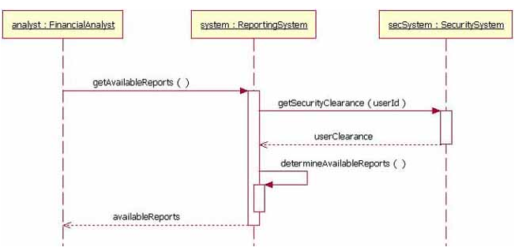
The basics : an example
Stefano Coluccia
07.07.2016

Slide 6
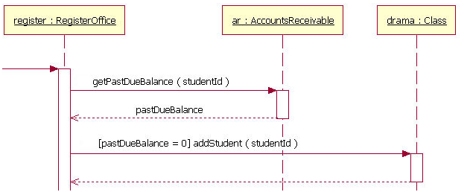
The basics : guards
Stefano Coluccia
07.07.2016
Guards
Sometimes it's necessary to evaluate a particular condition before to send a specific message. In this case we use the guards.
The guard element it's placed above the message line being guarded and in front of the message name
[Boolean Test]

Slide 7

The basics : the frame
Stefano Coluccia
07.07.2016
Frame
The frame element is optional in UML diagrams and provides a graphical boundary for the diagram.
Diagram's label begins with the letters "sd," for Sequence Diagram(activity = Activity Diagram, and use case = Use Case Diagram ecc. ).

Slide 8
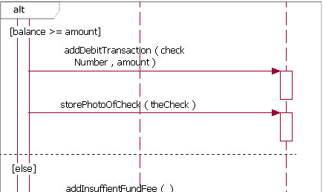
Combined fragments : alternatives
Stefano Coluccia
07.07.2016
Alternatives
A combined fragment is used to group sets of messages together to show conditional flow in a sequence diagram.
Alternatives allow the modeling of the classic "if then else" logic

Slide 9
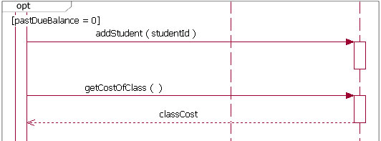
Combined fragments : Option
Stefano Coluccia
07.07.2016
Option
An option is used to model a simple "if then" statement
The text "opt" is placed inside the frame's namebox and there never can be an "else" guard

Slide 10
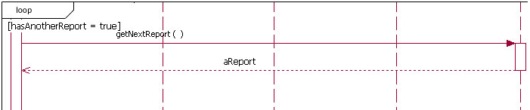
Combined fragments : Loops
Stefano Coluccia
07.07.2016
Loops
Similar in appearance to the option combination fragment(but frame's namebox is "loop"), it's used to model a repeating sequence.
There can be a booleant test and two special guards :"minint = [the number]" (e.g., "minint = 1") and maximum iterations written as "maxint = [the number]" (e.g., "maxint = 5")

Slide 11
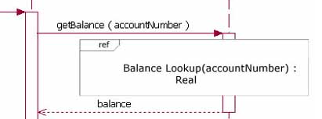
Beyond the basics : the interaction occurrence
Stefano Coluccia
07.07.2016
The interaction occurrence
The addition of interaction occurrences is arguably the most important innovation in UML 2 interactions modeling and it allows to reuse existing sequence diagrams.
The text "ref" is placed inside the frame's namebox and the name of the sequence diagram is placed inside the fragment with its parameters
Sequence diagram name[(arguments)] [: return value]

Slide 12
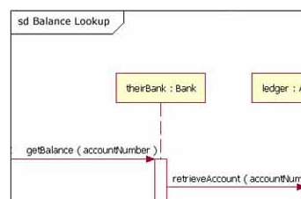

Beyond the basics : gates
Stefano Coluccia
07.07.2016
Gates
Gates can be an easy way to model the passing of information between a sequence diagram and its context.
A gate is merely a message that is illustrated with one end connected to the sequence diagram's frame's edge and the other end connected to a lifeline.

Slide 13
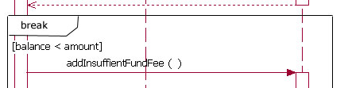
Beyond the basics : breaks
Stefano Coluccia
07.07.2016
Breaks
It's almost identical in every way to the option combined fragment, with two exceptions :
  a break's frame has a namebox with the text "break" instead of "option"
  the enclosing interaction's remainder messages will not be executed. It's like the break keyword in Java.

Slide 14
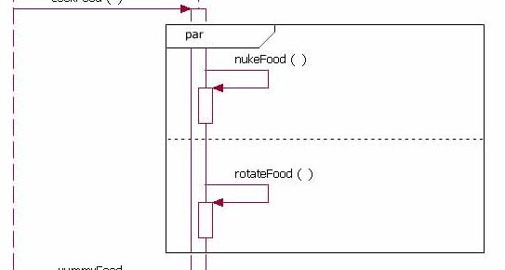
Beyond the basics : parallel
Stefano Coluccia
07.07.2016
Parallel
When the processing time required to complete portions of a complex task is longer than desired, some systems handle parts of the processing in parallel.
The text "par" it's placed in the frame's namebox
Each operand(separated by a dashed line) in the frame represents a thread of execution done in parallel.

Slide 15
Questions
Stefano Coluccia
07.07.2016
            ???????

